Slide 1
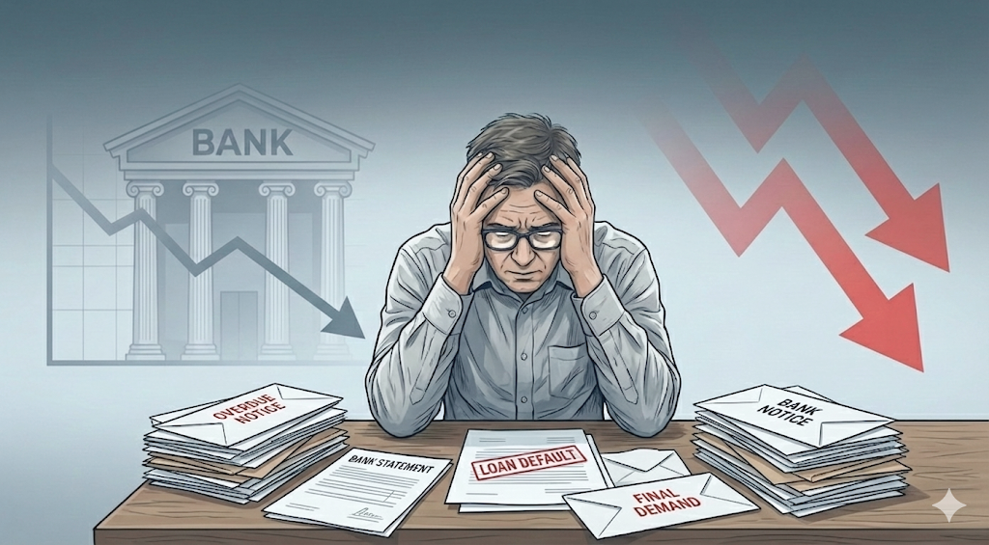




Loan Default
INSIDE LOAN DEFAULTS: RISK, PATTERNS, AND INSIGHTS

Slide 2


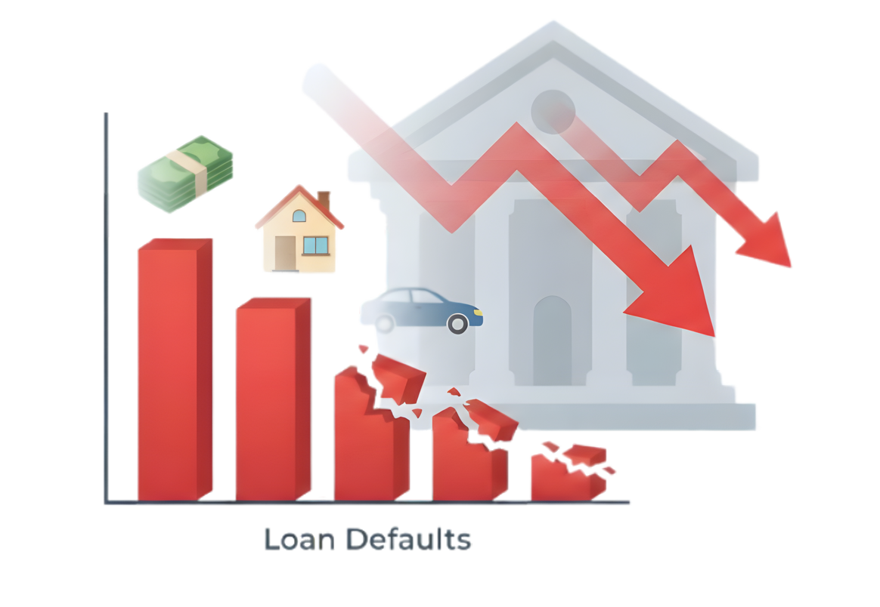
Did You Know?
Every year, thousands borrow to buy homes, cars, or study. But when repayments stop, banks suffer losses, and the economy slows down.
In 2023, Pakistani banks lost nearly Rs 995 billion, or roughly $3.5 billion, not by fraud but by everyday borrowers who couldn’t repay.
Sources: https://mettisglobal.news/bad-loans-surge-rs71bn-in-2023
Notes:
Imagine lending a friend money and never getting it back — now scale that to an entire banking system.
Last year alone, Pakistan’s banks lost almost one trillion rupees due to defaults.
Our study dives into who these defaulters are and how banks can predict them before it’s too late.

Slide 3

Patterns Behind Loan Defaults
Banks lend money so people can buy cars, houses, or study.
But not everyone pays it back on time....
These people are called loan defaulters, meaning they failed to repay their loans as promised.
Our project studies who is most likely to default and why, so banks can spot risks early and reduce future losses.
Notes:
Banks lend for homes, cars, or education, but not everyone pays back on time. These are called loan defaulters—people who stop making payments.
Our analysis helps banks see these risks before defaults happen

Slide 4
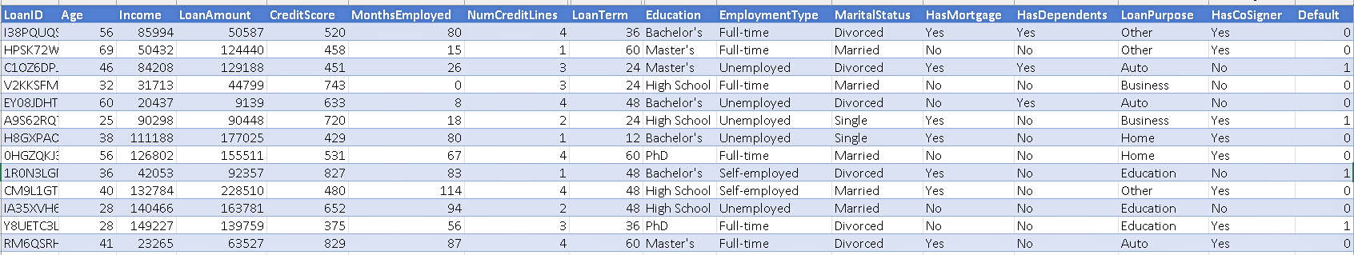
Dataset Overview
We Use:
Loan Default Prediction Dataset-Kaggle
The dataset contains: 255K Rows| 18 Columns
Sources: https://www.kaggle.com/datasets/nikhil1e9/loan-default
Sources: https://mettisglobal.news/bad-loans-surge-rs71bn-in-2023
Notes:
We used a Kaggle dataset with over 255 thousand loan records and 18 columns. It covers everything from income and credit score to employment and marital status

Slide 5
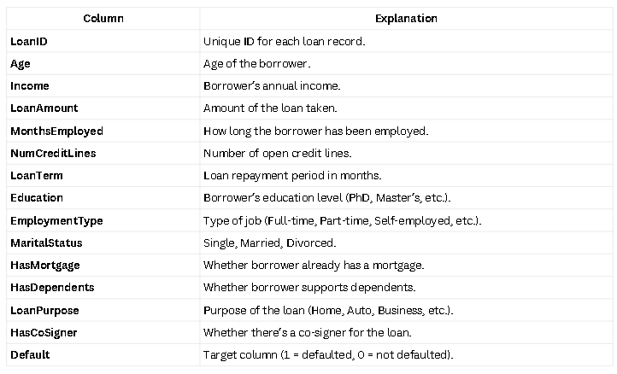
Sources: https://www.kaggle.com/datasets/nikhil1e9/loan-default

Slide 6
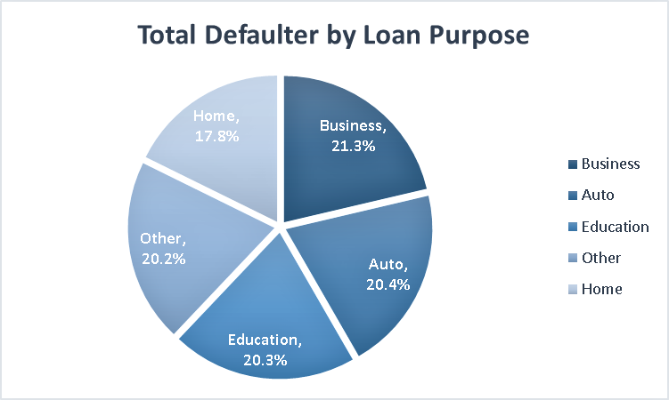
“Business and auto loans are riskiest”
Business and auto loans make up the largest share of defaults, about 21%, higher than home loans.
Notes:
Business and auto loans are riskiest. Borrowers taking these loans default around 21 percent, higher than others.

Slide 7
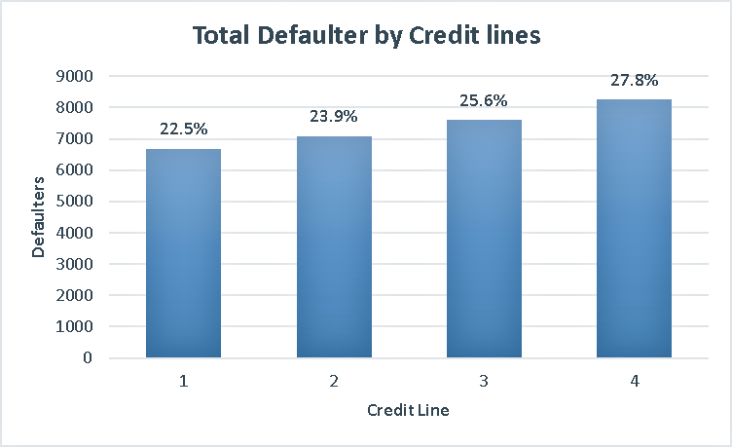
“More credit lines, more payment risk”
Defaults rise as credit lines increase, from 23% at one line to 28% at four lines.
Notes:
As credit lines increase, so does the chance of default—from 23 percent for one line to nearly 28 percent for four. More credit means more debt pressure

Slide 8
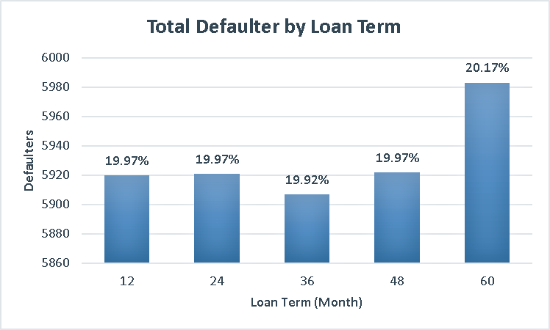
“Longer repayment, higher risk”
Defaults increase for longer loan terms, peaking near 60 months.
Notes:
Defaults rise for longer loan terms. Borrowers with 60-month loans default most often, possibly because long commitments make repayment harder

Slide 9
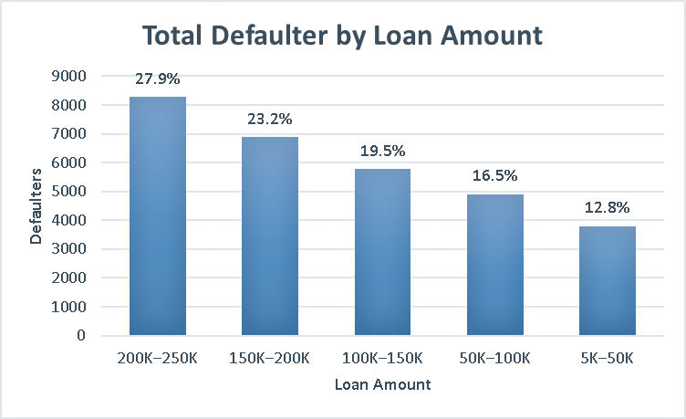
“Bigger loans, bigger risk”
Defaults rise sharply for larger loans, reaching nearly 28% for loans above 200K.
Notes:
Large loans are riskier. Borrowers with loans above 200 K default at about 28 percent, compared to 13 percent for small loans.

Slide 10
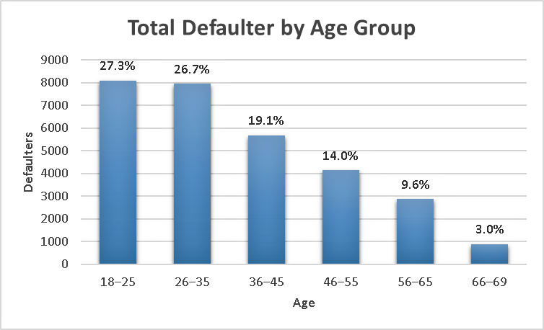
“Younger borrowers default more”
People under 35 default most, while older adults rarely miss payments.
Notes:
Younger borrowers, especially under 35, are more likely to default. Older borrowers tend to manage money and commitments more carefully.

Slide 11
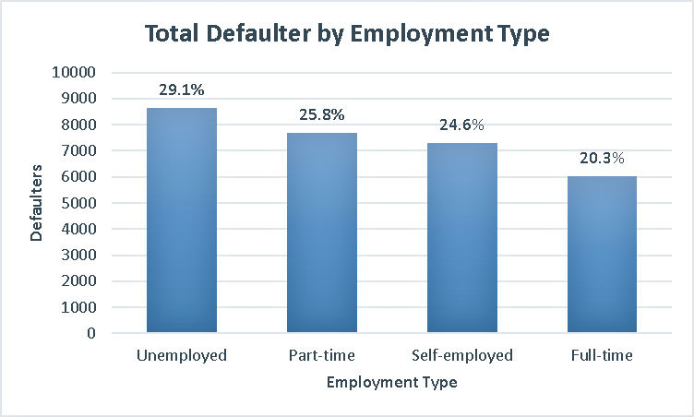
“Full-time workers default less”
Unemployed borrowers default 44% more than full-time employees
Notes:
Employment stability matters. Unemployed borrowers default 44 percent more than those working full-time.

Slide 12
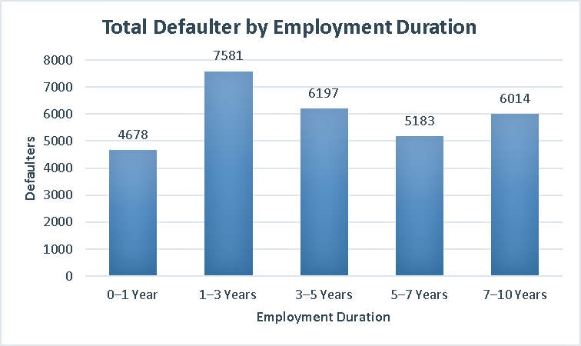
“Short-term jobs, higher risk”
Defaults are highest among borrowers with 1–3 years of work experience.
Notes:
Those with only 1–3 years of experience default most, showing that short job history links to weaker repayment ability

Slide 13
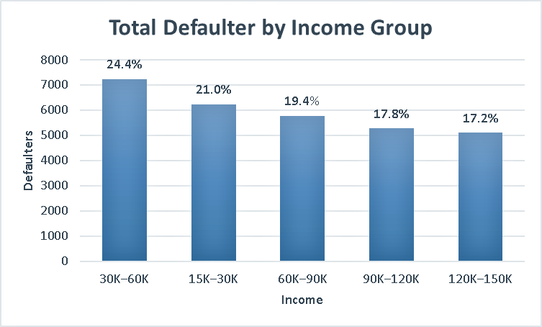
“Lower income, higher default chance”
Borrowers earning between 30K–60K show the highest default rate 24.4%.
Notes:
Borrowers earning between 30 K–60 K default the most—about 24 percent—while higher earners have better repayment habits.

Slide 14
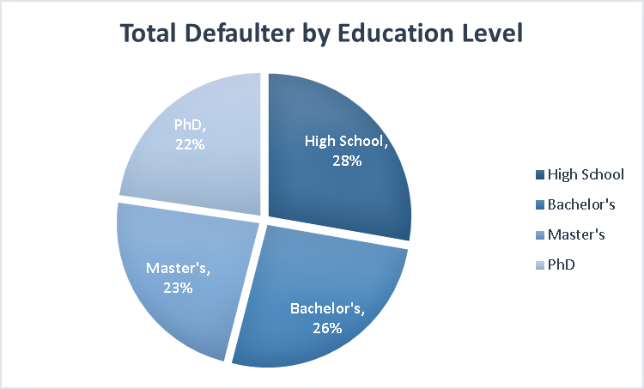
“Higher education, better repayment”
High school-educated borrowers default 28%, which is about 23% higher than PhD holders.
Notes:
Married borrowers repay better. Divorced individuals default 20 percent more, possibly due to financial stress or single income.

Slide 15
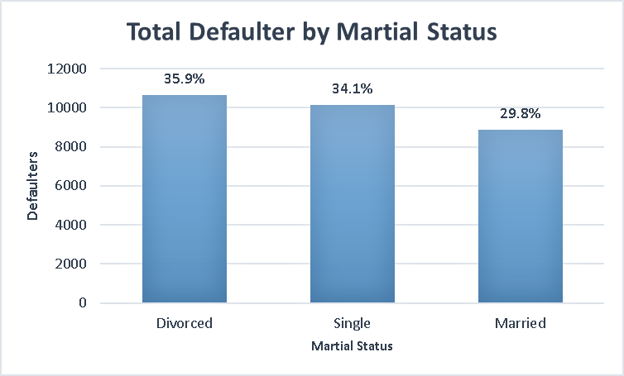
“Married borrowers repay better”
Divorced individuals default 20% more than married ones
Notes:
Marital status also influences repayment discipline. Married borrowers are more stable financially, while divorced individuals face around 20 percent higher default risk,

Slide 16
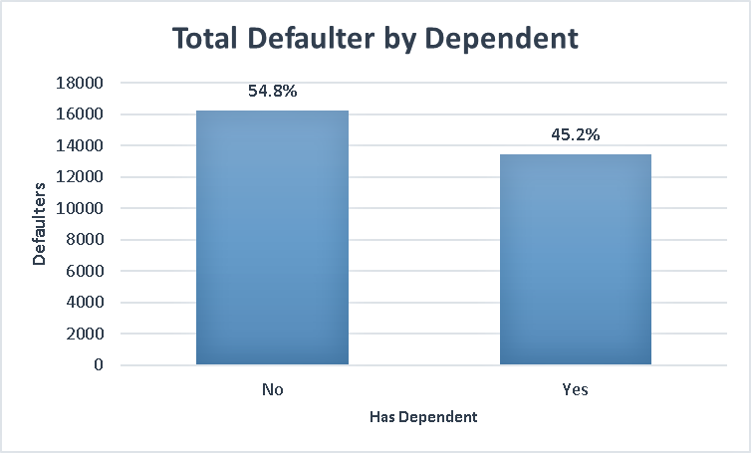
“No dependents, higher default”
People without dependents make up 55% of all defaulters
Notes:
People without dependents default more—about 55 percent of all defaulters—likely because they have less financial responsibility.

Slide 17
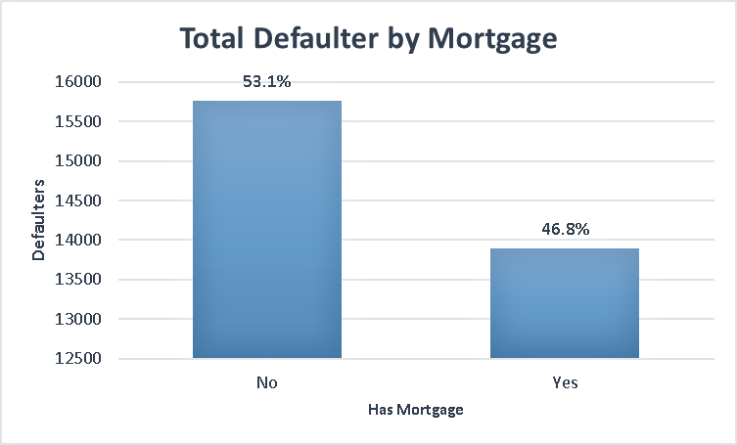
“Mortgage holders manage money better”
Those with mortgages default 47%, vs. 53% without
Notes:
Borrowers who already have a mortgage actually manage money better. Their default rate is lower—47 percent compared to 53 percent for others

Slide 18

“Co-signers lower default risk”
Loans with a co-signer default 44%, lower than solo borrowers.
Notes:
Having a co-signer cuts default risk. When someone shares responsibility, borrowers tend to be more careful.

Slide 19

What We Found
Borrowers under 50 and those without dependents are more likely to default on their loans.
Defaults increase with more credit lines, showing higher risk among borrowers managing multiple accounts.
Business and Auto loans have the highest default rates, while Home loans remain the most stable.
Divorced and unemployed borrowers face the greatest repayment risk, while married and full-time workers are more reliable.
High school–educated borrowers show higher defaults than those with advanced education, highlighting the link between education and financial responsibility.
Lower-income borrowers (30K–60K) default most often, while higher earners (above 120K) default least.
Notes:
Overall, younger, low-income, less-educated, and unemployed borrowers are at the highest risk of default.

Slide 20

What Banks Should Do
Tighten screening for high-risk applicants, especially younger borrowers and those without dependents.
Monitor customers with multiple credit lines and offer guidance to manage their debts better.
Apply stricter loan approval rules or higher interest buffers for Business and Auto loans, while keeping Home loans customer-friendly.
Track divorced and unemployed clients closely and provide repayment support options to reduce defaults.
Promote financial awareness programs for low-income or less-educated customers to improve repayment behavior.
Notes:
Banks can manage this risk by tightening screening, improving monitoring, and offering financial-literacy programs.
These steps not only reduce losses but also promote responsible borrowing

Slide 21
Default Prediction

Slide 22
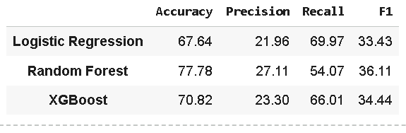
Model Evaluation
Accuracy → How well the model predicts overall loan outcomes (both defaulters and non-defaulters) correctly.
Precision → Out of predicted defaulters, how many were actually correct?
Recall → Out of all real defaulters in the data, how many did the model successfully identify?
F1-Score → The balance between precision and recall (risk control indicator).
Notes:
Among all tested models, Random Forest achieved the best overall accuracy (77.8%), but Logistic Regression achieved the highest recall (≈70%), providing a solid foundation for identifying high-risk borrowers.
Its high recall means the model catches most actual defaulters, making it valuable for minimizing financial losses.

Slide 23
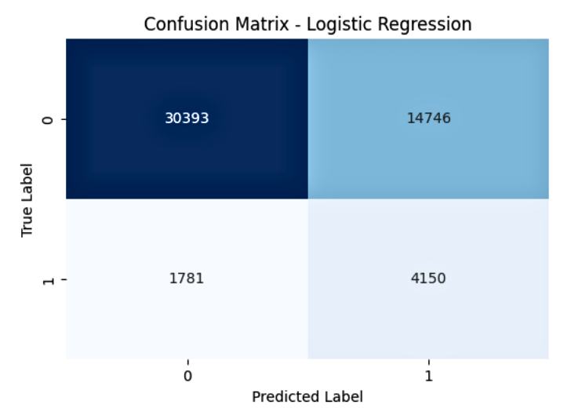
The model correctly predicted:
30,393 safe borrowers (non-defaulters)
4,150 actual defaulters
Notes:
The confusion matrix shows that our Logistic Regression model performs well in identifying true non-defaulters, with 30,393 correct predictions. However, it also generates false alarms, predicting 14,746 safe borrowers as defaulters. Despite this, the model successfully captures around 70% of actual loan defaulters, which is valuable for minimizing financial risk. The trade-off between precision and recall indicates a risk-aware model that prioritizes catching potential defaulters even at the cost of some false positives.

Slide 24
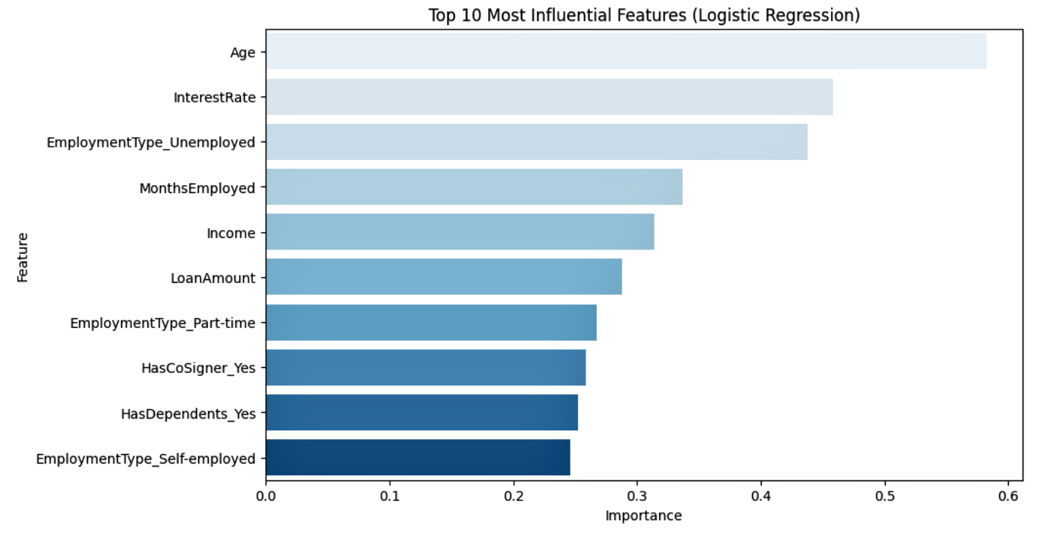
Notes:
The model reveals that financial stability and employment status are the most powerful predictors of loan default.
In particular, younger age, unemployment, high interest rates, and shorter employment history increase the risk, while steady income and co-signers reduce it.

Slide 25

Any Questions

Slide 26



Thank You

